Slide 1

File Construction Workshop
Year 1
Original content: CTLD 2020
Updates: Kerri Sowers Fall 2024

Slide 2


Today’s Session
Important Resources
Year 1 File Construction
Developing your faculty plan
Questions

Slide 3

Important Resources
Locally Negotiated Agreements
Faculty Evaluation Procedure MOA
Faculty Evaluation Policy (University Standards – section 6.00 and 10.0)
Program Standards
School Standards
Online Course MOA
Personnel Actions Calendar
Summary Due Dates

Slide 4

Purpose of File Review
Procedure required by MOA
Self-reflect on performance
Receive feedback from PRC and Dean
Develop evidence and narrative for future files

Slide 5

File Construction Approach
YR 1 file is due by 5pm on February 4th
Review MOAs, Policy, & Standards
Talk with your mentor & colleagues for samples & advice
Consider your audience (PRC, Dean)
Gather artifacts/evidence of excellence
Engage in thoughtful self-reflection
Utilize FAWN sessions

Slide 6

Required First Year File Content
Background Materials
  File cover page (School uploads)
  Position description/responsibilities (School uploads)
  Current Curriculum Vitae (CV)
Reflection/Narrative
Artifacts & Evidencel)

Slide 7
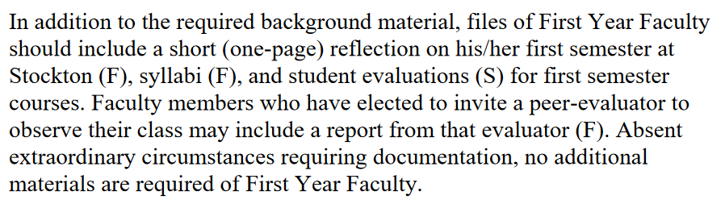
Required First Year File Content
Faculty Evaluation MOA, page 5-6

Slide 8

Current CV
Formatted for Stockton’s file review process
Teaching section
Scholarship section
  Presentations
  Conferences
  Scholarly & Creative Works
Service section
  Program
  School
  University
  Professional/External

Slide 9
Reflection
A “short (one-page) reflection” about your first semester
Narrative will primarily reflect on teaching
Should include general plans for scholarship and service

Slide 10
Artifacts & Evidence
Syllabi for Fall courses
IDEA (or small class instruments) for Fall courses
Optional: Peer observation(s)
Optional: other evidence completed during Fall semester

Slide 11

Mistakes to Avoid
Missing or inaccurate CV information
Not considering the readers when writing (consider clarity, brevity, & specificity)
Failing to reference the standards for excellence in teaching, service and scholarship (& promotion)
Failing to provide evidence
(Referencing the standards and providing evidence become more important after the year one file)

Slide 12
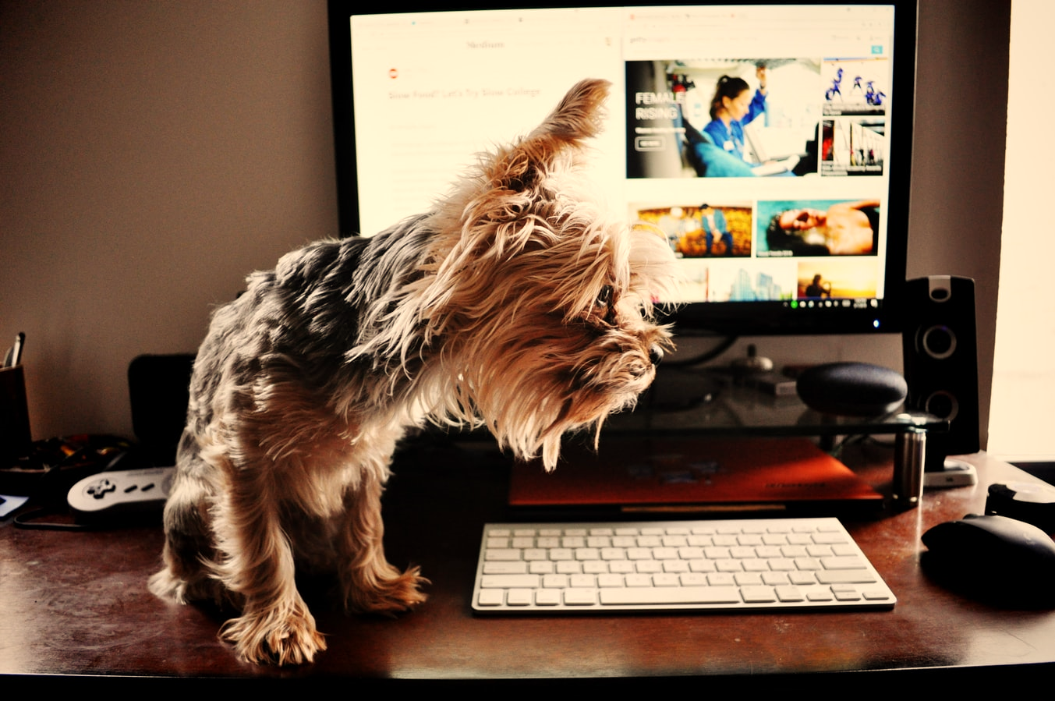
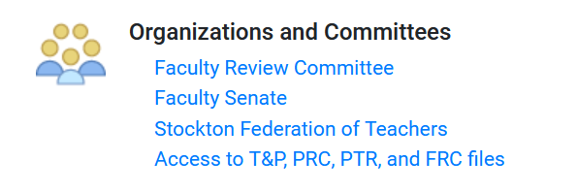
Uploading File Content
Login Instructions
Upload = Slow process
Login to Go Portal, click on Faculty tab…on the left navigation panel look for:

Slide 13
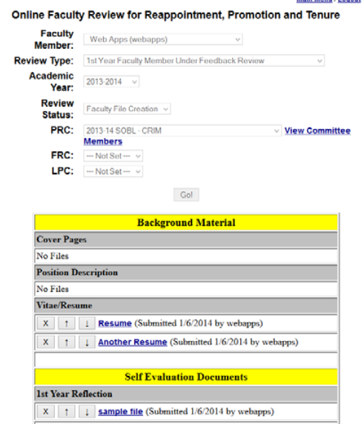
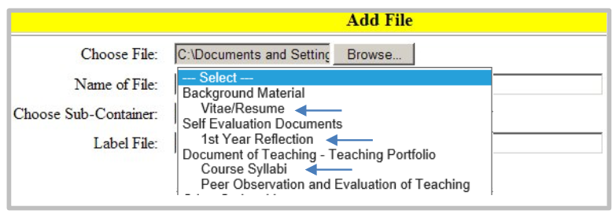
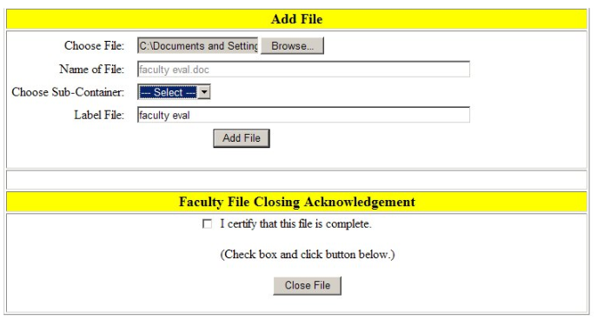

Slide 14
Next Step:
Program Review Committee (PRC)
The PRC consists of either all or most of the tenured members of your program
  Minimum of 3 tenured faculty members
  Large programs (>10 tenured faculty members) the PRC will consist of at least 7 members, elected by simple majority
Feedback years - years 1 and 3
  The PRC will review your file, meet with you to discuss your file and progress, and document the feedback in a letter that will be uploaded to your file
Decision years - years 2 and 4; Tenure decision – year 5
The PRC can only consider the information in the file when providing feedback or decisions
You are allowed to write rebuttal letters at each stage of the process (PRC, Dean, etc.)
  You have 3 days (rebuttal letters are usually due by 2 PM)
  Reach out to the Union and CTLD for assistance

Slide 15

Next Step: Dean Review

Slide 16
Preparing for Year 2
Peer Observations
  Required 2 per year (consider online/hybrid courses)
Faculty Plan (Draft)
  Address Standards
  Specific but Flexible
  Not a Contract
Second Year File
  More depth and evidence – decision year

Slide 17
Faculty Plan
Prior to the second Precepting Date of the second semester (year 1)
  The chair of the PRC shall convene a meeting with the faculty member, PRC and the Dean to discuss draft Plans
Prior to the first Precepting Day of the fall semester (year 2)
  Draft Plans should be reviewed and approved/disapproved by the PRC (see page 28/29 of the Faculty Evaluation MOA)
There may be revisions to a plan with approval from the PRC

Slide 18
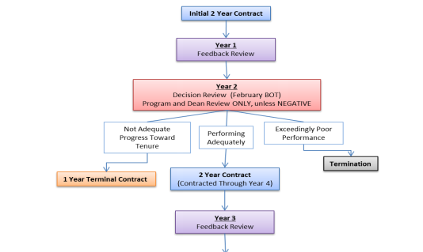
Stockton University MoA: Procedure for the Evaluation of Faculty & Library Faculty (2015)

Slide 19
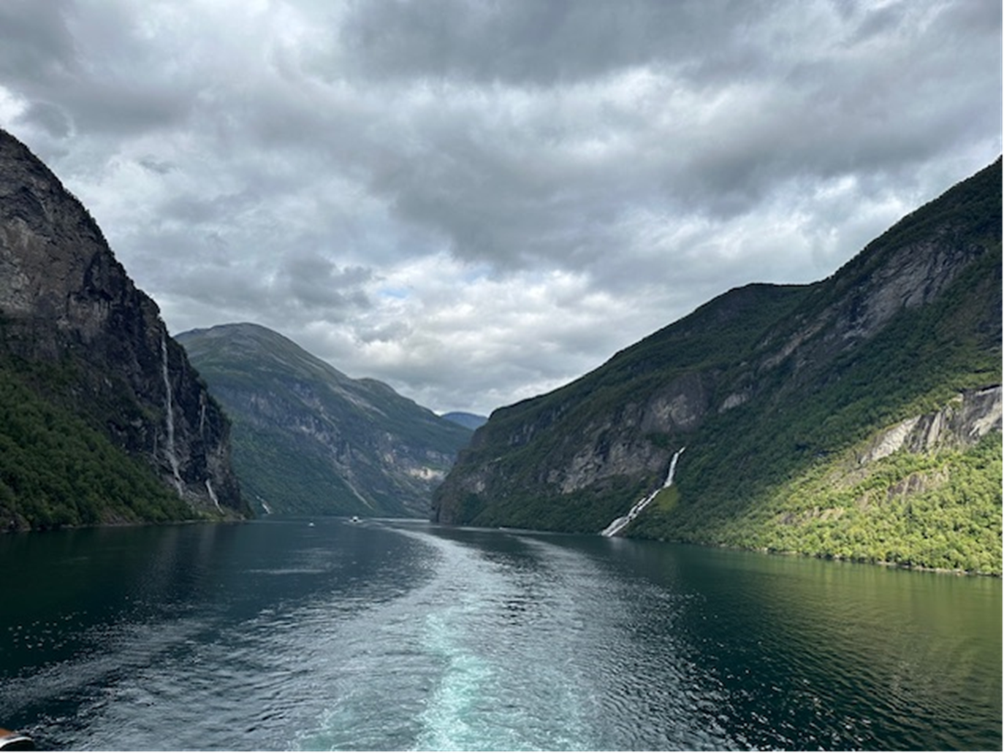
Questions??

