Slide 1
Chrome River: Pre-Approval Reports
DISBURSEMENT SERVICES

Slide 2
Creating & Tracking Pre-Approval Reports Demonstration

Slide 3
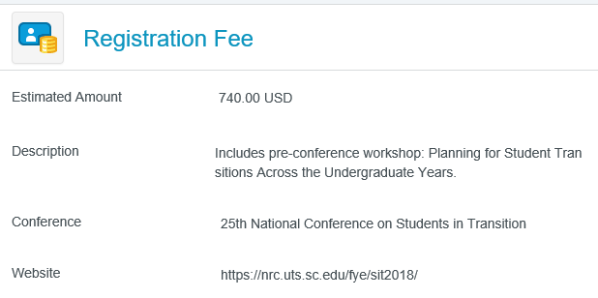
Pre-Approval Reports – Tips & Reminders
Temporary org – 000000 can be used if end user is unsure of foapal. Best Practice-start typing the name of your org, use 110005 as fund, and pick appropriate program. This can always be changed if not correct.
Include the destination in the business purpose.
Conference website should always be included for conferences. This field is located under Registration Fee.
Website can also be added under comments if there is no Registration Fee.
Per Diem Wizard widget should be used so the system will give you the rate based on location.
Use “Other” Tiles if you don’t see a specific expense type listed.

Slide 4
Tips & Reminders…continued
Reduce the total approved amount on your Pre-Approval by using the Travel Expenses > Other Travel Expenses tile. Input a (-) and the dollar amount you would like deducted from your total with a description.
When submitting a report with no anticipated expenses, use the Travel Expenses > Other Travel Expenses tile, input $1.00 and note in the description box that there are no expenses for this report.
Approval for Attendance Forms will still need to be completed and submitted to the Office of Institutional Diversity & Equity. It is suggested that you put your Pre-Approval ID # (last 6 digits) on the top of the form.
“CR” and the last 6 digits should be placed in the reference field when reconciling WORKS transactions related to travel.

Slide 5
Pre-Approval Routing
Routing is based on Org
Proxy submits on behalf of the traveler
Traveler submits
Student Travel – SU Student

Slide 6
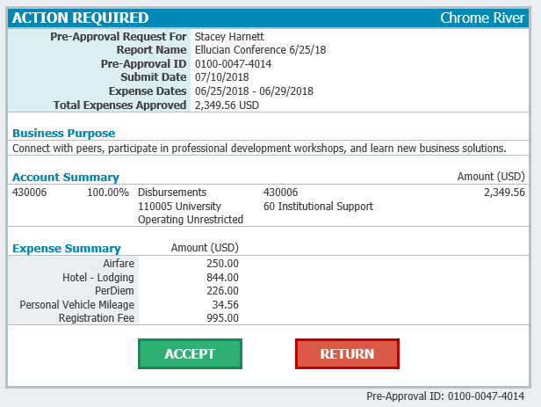
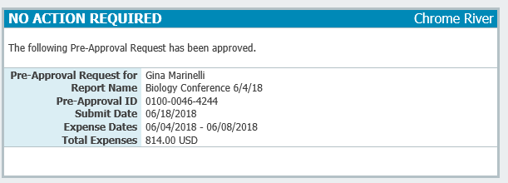
Emails from Chrome River
Email to Approve Report
Notification of Approval

